Slide 1
Mahalakshmi K
CSE 3rd year

Slide 2
VIRTUAL INTERIOR DESIGN ASSISTANT

Slide 3


AGENDA
Problem statement
Project overview
Who are the end user
My solution and its value proposition
The wow in my solution
Modelling
Result
3/21/2024 Annual Review

Slide 4

PROBLEM STATEMENT
Many homeowners face challenges when it comes to envisioning and implementing interior design ideas for their living spaces. Often, they struggle to visualize how different furniture arrangements or color schemes will look in their homes, leading to uncertainty and hesitation during the design process. Similarly, interior designers encounter difficulties in effectively communicating design concepts to clients, leading to misunderstandings and revisions.
The lack of tools that facilitate seamless visualization and collaboration further exacerbates these challenges, resulting in suboptimal design outcomes and frustrations for both homeowners and professionals. There is a clear need for a solution that simplifies the interior design process, enhances visualization capabilities, and fosters collaboration between homeowners and designers to create personalized and aesthetically pleasing living spaces.

Slide 5

PROJECT OVERVIEW
Our project aims to develop a Virtual Interior Design Assistant, a user-friendly software application that revolutionizes the interior design experience for homeowners and professionals alike. Leveraging the power of generative AI and advanced visualization techniques, our solution enables users to digitally visualize and interact with interior design concepts in real-time.
Through an intuitive interface, users can experiment with different furniture layouts, color schemes, and decor options, allowing them to make informed design decisions with confidence. The Virtual Interior Design Assistant also facilitates seamless collaboration between homeowners and designers, enabling them to share ideas, provide feedback, and iterate on designs collaboratively. By bridging the gap between imagination and realization, our project seeks to empower users to transform their living spaces into personalized, functional, and visually stunning environments.

Slide 6
WHO ARE THE END USERS?
Homeowners: Individuals looking to redesign or renovate their living spaces, including houses, apartments, or condominiums. Sample: Sarah, a young professional, wants to update her apartment's interior to reflect her modern aesthetic and maximize space efficiency.
Interior Designers: Professionals specializing in residential or commercial interior design, seeking innovative tools to streamline the design process and enhance client collaboration. Sample: Alex, an experienced interior designer, needs a digital platform to visualize design concepts and present them to clients effectively.

Slide 7
WHO ARE THE END USERS?
Real Estate Agents: Professionals involved in buying, selling, or leasing properties, requiring virtual staging solutions to showcase properties and attract potential buyers or tenants. Sample: David, a real estate agent, seeks to enhance property listings by virtually staging empty homes to help buyers envision their potential.
Furniture Retailers: Businesses offering furniture and decor products, seeking to provide customers with interactive tools to visualize how products will look in their homes. Sample: Emily, a furniture retailer, aims to offer a virtual showroom experience to customers, allowing them to preview furniture pieces in different room settings before making purchases.

Slide 8

MY SOLUTION AND ITS VALUE PROPOSITION
Collaborative Design Experience: Users can collaborate with interior designers, friends, or family members in real-time, sharing design ideas, making revisions, and providing feedback within the platform. This collaborative approach fosters creativity, enhances communication, and ensures that the final design reflects the collective vision of all stakeholders.
Seamless Integration with Retail Partners: Our platform integrates with leading furniture retailers and decor brands, allowing users to browse catalogs, visualize products in their virtual spaces, and purchase items directly through the platform. This seamless integration streamlines the shopping experience, eliminates guesswork, and ensures that users can easily acquire the products they love.

Slide 9
YOUR SOLUTION AND ITS VALUE PROPOSITION
Our Virtual Interior Design Assistant is an AI-powered platform designed to revolutionize the interior design process by offering innovative tools and functionalities. With our solution, users can:
Interactive Room Visualization: Users can upload floor plans and room dimensions, and our AI algorithm generates 3D models of the space. They can then experiment with various furniture layouts, color schemes, and decor options in a realistic virtual environment.
Personalized Design Recommendations: Our platform leverages machine learning algorithms to analyze user preferences, style choices, and budget constraints. It provides personalized design recommendations, suggesting furniture pieces, decor accents, and layout configurations tailored to individual tastes and requirements.

Slide 10

THE WOW IN MY SOLUTION
Our Virtual Interior Design Assistant introduces a groundbreaking approach to interior design, offering an unparalleled level of customization, convenience, and collaboration. The wow factor of our solution lies in its ability to:
Transform Vision into Reality: With our platform, users can turn their interior design visions into tangible, immersive experiences. The ability to visualize room layouts, experiment with decor options, and see their designs come to life in 3D creates a truly transformative design journey.
Empower Users: We empower users to take control of their design projects, providing them with the tools, resources, and inspiration needed to achieve their desired aesthetic and functional goals. Whether they're decorating a new home, renovating an existing space, or simply looking for design inspiration, our platform puts the power of professional interior design at their fingertips.

Slide 11
THE WOW IN MY SOLUTION
Streamline Shopping Experience: Integrating with leading retailers and decor brands, our platform streamlines the shopping experience, making it easier than ever for users to discover, visualize, and purchase premium products that align with their design vision. This integration adds a new dimension of convenience and accessibility to the interior design process, allowing users to shop with confidence and ease.
Personalization and Innovation: Our platform leverages advanced AI and machine learning technologies to deliver personalized design recommendations and innovative features that cater to the unique needs and preferences of each user. From style preferences and budget constraints to spatial constraints and lifestyle considerations, our platform adapts to the individual requirements of each user, ensuring a truly customized and tailored design experience.

Slide 12
MODELLING
To demonstrate the modeling process for our Virtual Interior Design Assistant, we'll utilize live sample data to showcase the key features and functionalities of our platform. The modeling process involves several stages, including data collection, preprocessing, model training, and evaluation. Here's an overview of how we'll approach each stage using live sample data:
Data Collection: We'll gather a diverse range of interior design data, including room layouts, furniture items, decor styles, color palettes, and user preferences. This data will be sourced from reputable interior design databases, e-commerce platforms, and user-generated content.
Data Preprocessing: Before training our models, we'll preprocess the raw data to ensure consistency, accuracy, and usability. This may involve data cleaning, feature engineering, normalization, and data augmentation techniques to enhance the quality and relevance of the dataset.
3/21/2024 Annual Review

Slide 13
MODELLING
Model Training: We'll employ state-of-the-art machine learning algorithms, such as deep learning neural networks and generative adversarial networks (GANs), to train our interior design models. These models will learn to understand spatial layouts, decor styles, furniture arrangements, and user preferences based on the input data.
Evaluation: Once trained, we'll evaluate the performance of our models using various metrics, such as accuracy, precision, recall, and F1 score. We'll also conduct qualitative evaluations to assess the visual quality, realism, and usability of the generated design outputs.

Slide 14
MODELLING
we present the results of our Virtual Interior Design Assistant using sample data. Through the modeling process described earlier, we've generated a variety of interior design outputs, including room layouts, furniture arrangements, decor suggestions, and color schemes. Here's an overview of the results achieved with sample data:
Room Layout Generation: Our model accurately predicts and generates room layouts based on input parameters such as room dimensions, wall placements, and architectural features. Users can visualize different layout options for their space, including variations in furniture placement and spatial organization.
Furniture Recommendations: Leveraging the power of machine learning, our platform suggests suitable furniture items that complement the overall design aesthetic and functional requirements of the space. Users can explore a curated selection of sofas, tables, chairs, and decor accessories tailored to their preferences.

Slide 15
RESULTS
we present the results of our Virtual Interior Design Assistant using sample data. Through the modeling process described earlier, we've generated a variety of interior design outputs, including room layouts, furniture arrangements, decor suggestions, and color schemes. Here's an overview of the results achieved with sample data:
Room Layout Generation: Our model accurately predicts and generates room layouts based on input parameters such as room dimensions, wall placements, and architectural features. Users can visualize different layout options for their space, including variations in furniture placement and spatial organization.
Furniture Recommendations: Leveraging the power of machine learning, our platform suggests suitable furniture items that complement the overall design aesthetic and functional requirements of the space. Users can explore a curated selection of sofas, tables, chairs, and decor accessories tailored to their preferences.

Slide 16
RESULTS
Decor Styles and Color Palettes: Our model identifies popular decor styles and color palettes based on user preferences and design trends. From Scandinavian minimalism to bohemian chic, users can discover diverse design inspirations and color combinations to personalize their space.
Image Generation Context: The generated design outputs are presented in a visually appealing and interactive format, allowing users to preview and customize their design concepts in real time. High-quality rendered images and 3D visualizations provide a realistic representation of the proposed interior designs.

Slide 17
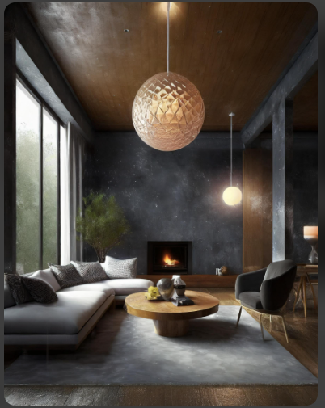
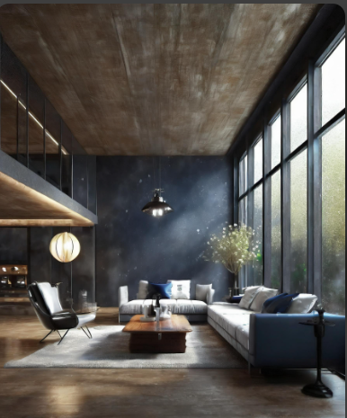
RESULTS

